Slide 1
INTRODUCTION TO Data Components/ SQL SERVER

Slide 2
What is Data
Data is a piece of information.
All critical data needs to stored for future references
Also the data needs to be shared with different people as and when required
Data Storage Mode : Paper, Notebooks, Files(Excel, Word), Data Management Tools(SQL SERVER, MYSQL, ORACLE)
Notebooks/
Papers
File Systems
DBMS
RDBMS
ORDBMS
Evolution of Data

Slide 3
File System vs. Database
File System
Database
Data can be stored locally
Multiple versions of data as client will have its own copy.
Does not have a client – server architecture so data is stored locally.
Does not have standardized commands to connect with applications
Data can be stored in server and can be access by clients
Single version of Data using client –server architecture
Based upon client – server architecture and data is stored in the server.
Standard commands to connect from different software applications.

Slide 4
A Database Management System is a collection of programs that allows users to specify the structure of a database, to create, query and modify the data in the database and to control access to it. (e.g. limit access to the database so that only relevant staff can access details of enrolling students)
Advantage of DBMS
• It stores data in centralized server. [ e.g. : single data server]
Mail server, Banking, Reservation: centralized
o Data is being updated instantly.
o Client – Server architecture – single server – multiple clients.
o It supports disaster recovery. We can back up the data in remote locations.
o We can backup and restore the data instantly.
Security: we can give access to different users depending upon roles.
o Transactions: data can be rolled back.
Either all the tasks should be completed or it should be rolled back to the original position.

Slide 5
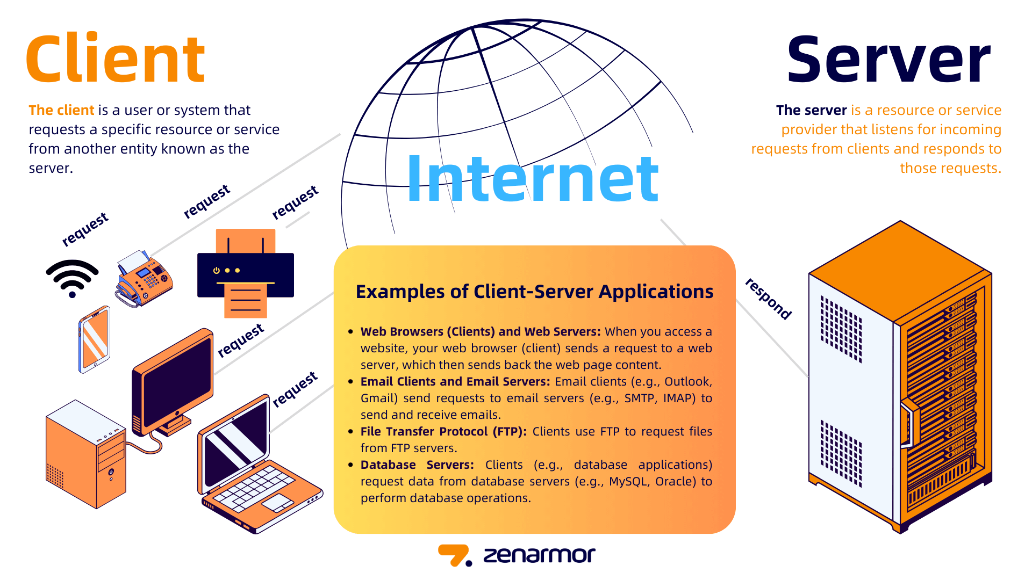
Client Server Architecture

Slide 6
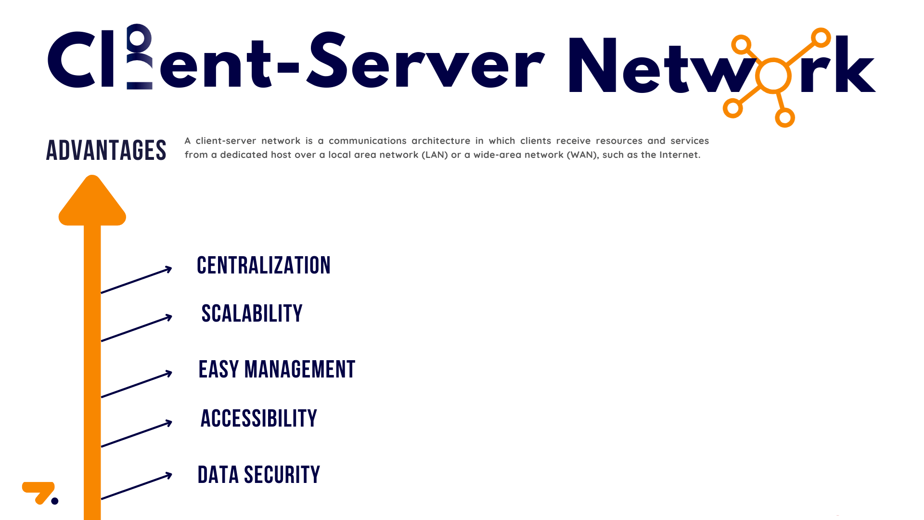

Slide 7
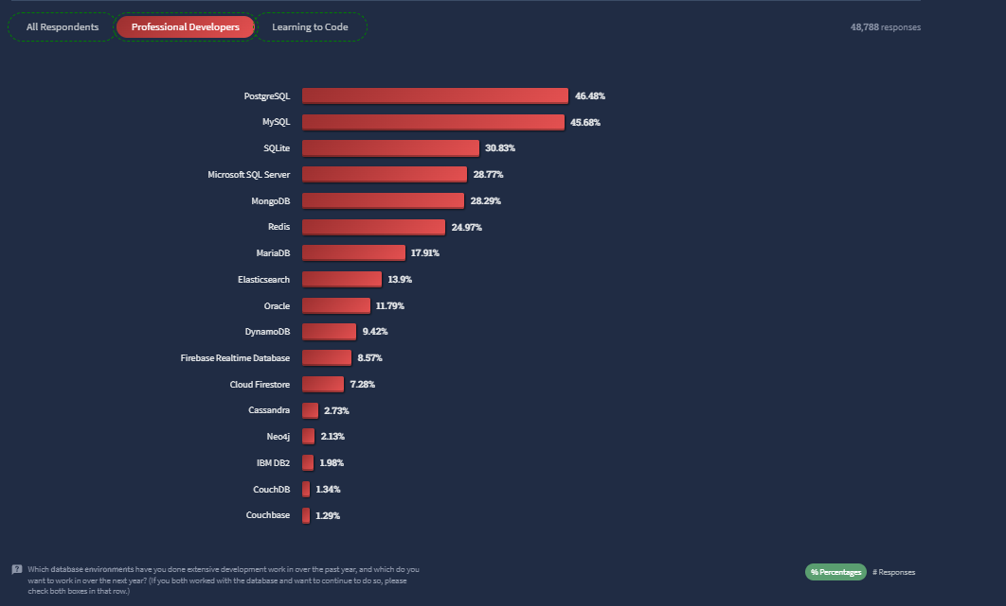
Popular Database Software's

Slide 8
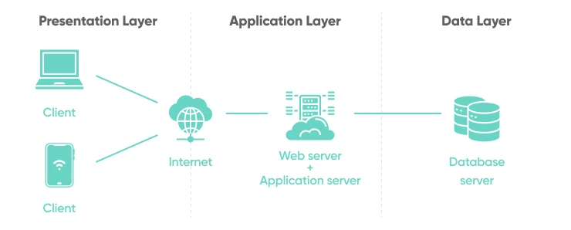
Application Architecture

Slide 9
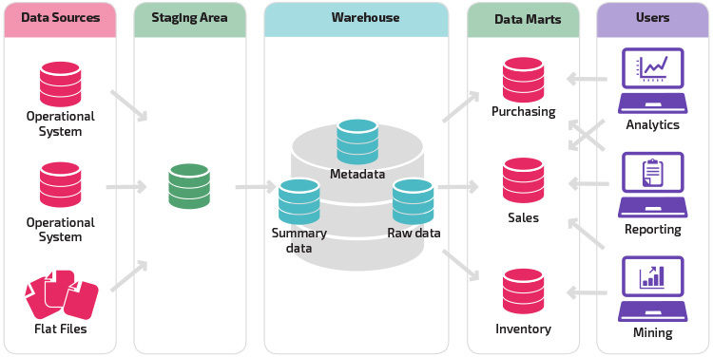
Different Types of Systems, Databases & Reporting Tools

Slide 10
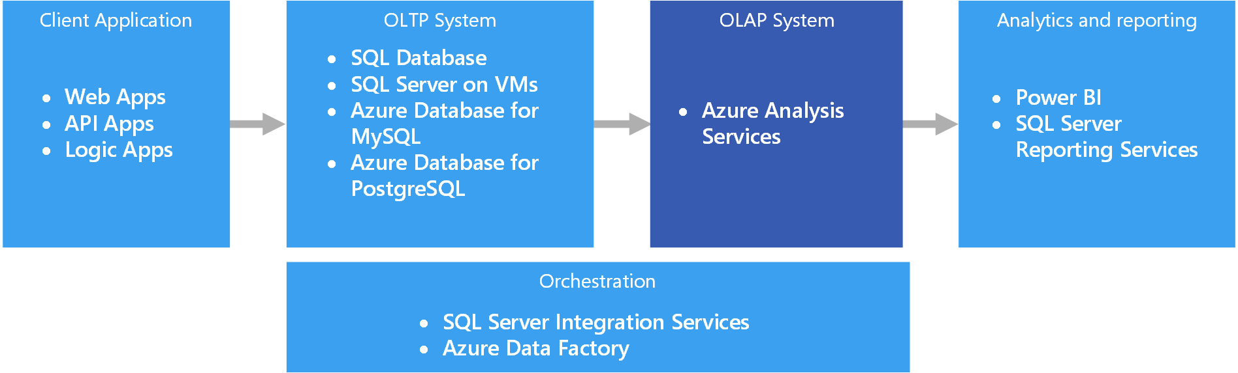
Different Types of Systems, Databases & Reporting Tools

Slide 11
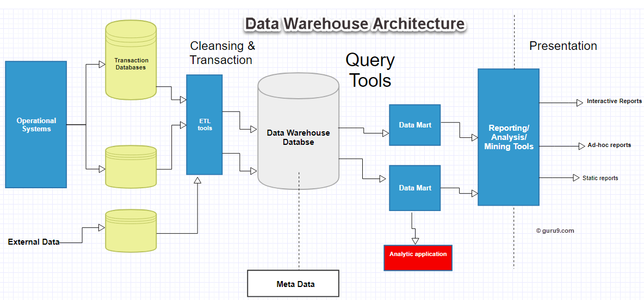
Different Types of Systems, Databases & Reporting Tools

Slide 12
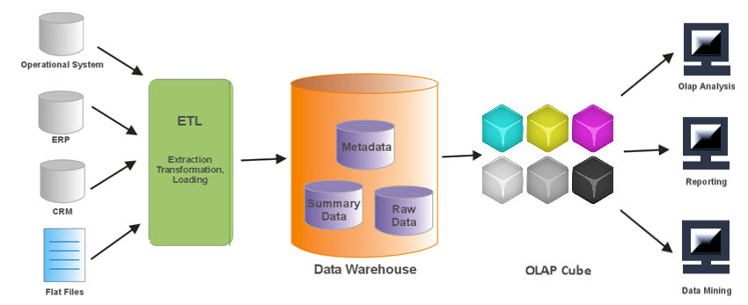
Different Types of Systems, Databases & Reporting Tools

Slide 13
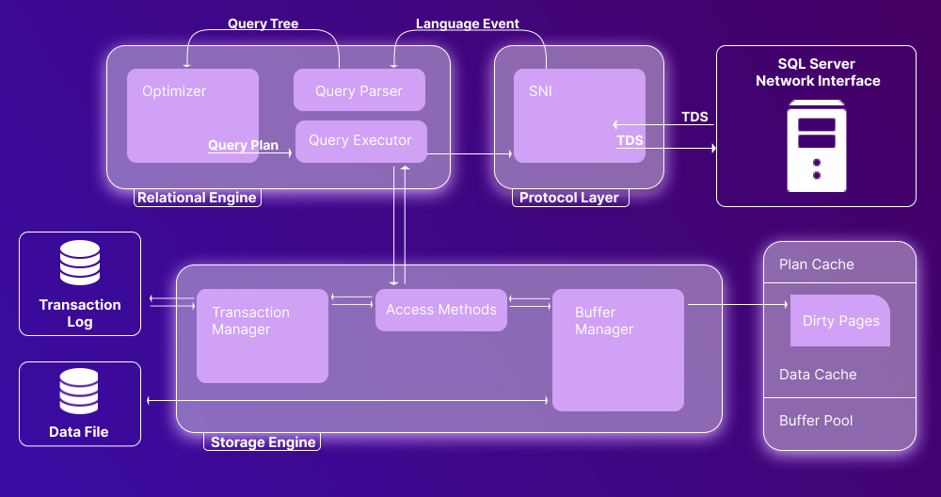
Sql Server Architecture

Slide 14
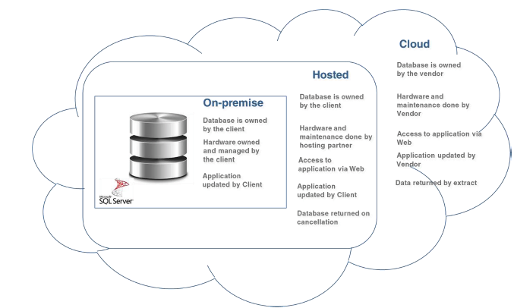
Sql Server Deployed / Installation

Slide 15
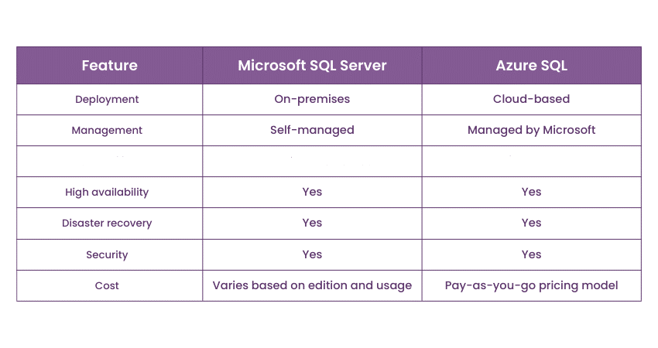
Diff between OnPremise & Azure Cloud

Slide 16
THANK YOU

